Slide 1



CA PBIS Conference
October 28-29, 2019
The Power of the
High School
Classroom Matrix
Cristy Clouse
Patti Hershfeldt
Barbara Kelley
www.pbiscaltac.org

Slide 2
Magic Matrix
for Today
Framing
Doing it Together
Applying
Acknowledging
Prompting
Responding
Self-Monitoring
Aligning

Slide 3
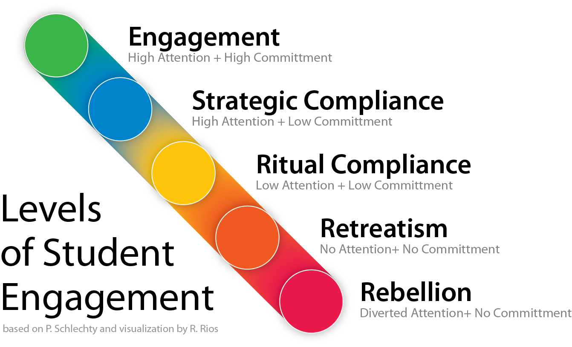

PBIS Master Wizard says…
“It doesn’t work in high schools without student engagement”
  -Rob Horner

Slide 4


ENGAGEMENT in this break out session will be defined as…
Positively
Stated
Observable
Measurable
Applicable
Notes:
Engagement – Behavior
Routine – Break out session

Slide 5
Tiered Fidelity Inventory (TFI)
“…the key to successful classroom management is prevention of problems before they start,
not knowing how to deal with problems after they have begun.”
–George Sugai and Brandi Simonson
Tiered Fidelity Inventory FEATURE
1.8 Classroom Procedures: Tier I features (school-wide expectations, routines, acknowledgements, in-class continuum of consequences) are implemented within classrooms and consistent with school-wide systems.
Notes:
Classroom-wide PBIS focuses on designing environments and adult behaviors directly impacting student social behavior and learning. Classroom environments consistently implementing effective practices (structure, expectations, engagement, feedback and consequences) support and promote academic, behavior and social success for ALL students.

Slide 6

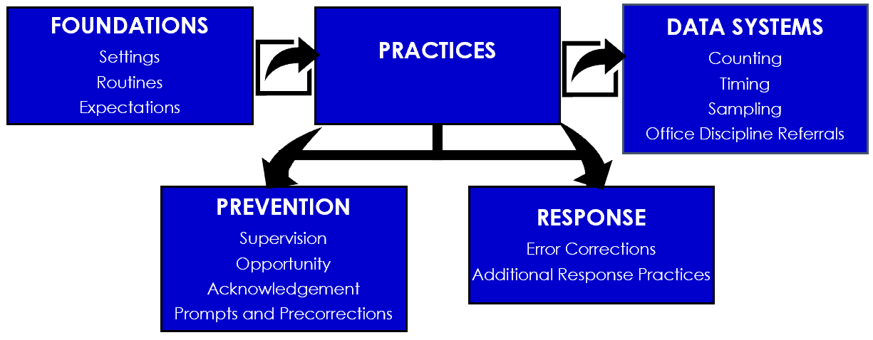
Positive Classroom
Behavior Supports(PCBS)

Slide 7
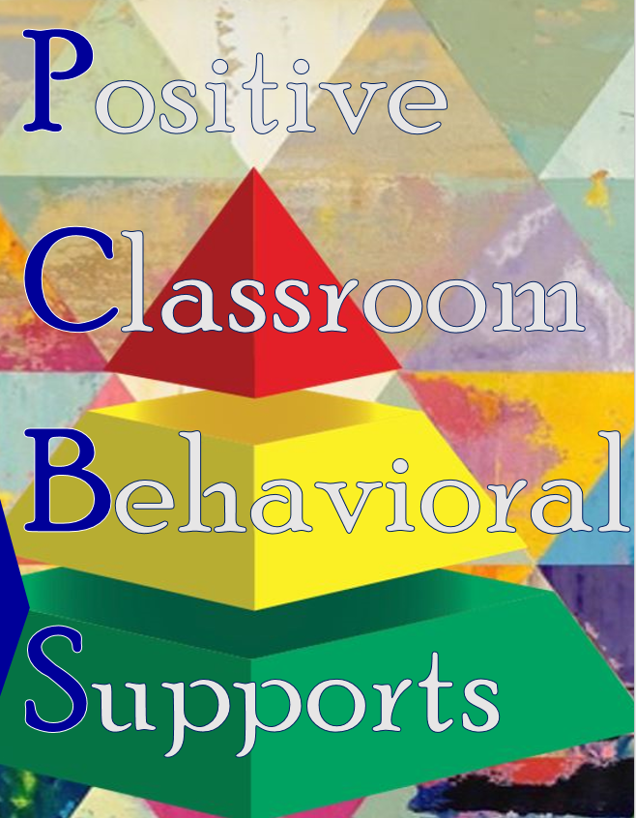
Positive Classroom Behavioral Supports Self-Assessment Survey Adapted from Supporting and Responding to Behavior PBIS Technical Brief on Classroom PBIS Strategies 1) I never have heard of this practice. 2) I have implemented this practice, but I am inconsistent. 3) I implement this practice regularly in my classroom. 4) I implement this practice regularly and I am interested in how others are implementing the practice.
Classroom Supports | Evidence-based Practices | Scale of 1-4
FOUNDATIONS Settings Routines Expectations | SETTINGS: I effectively design the physical environment of my classroom. ROUTINES: I develop and teach predictable classroom routines. EXPECTATIONS: I post, define and teach 3 to 5 positive classroom expectations.

Slide 8
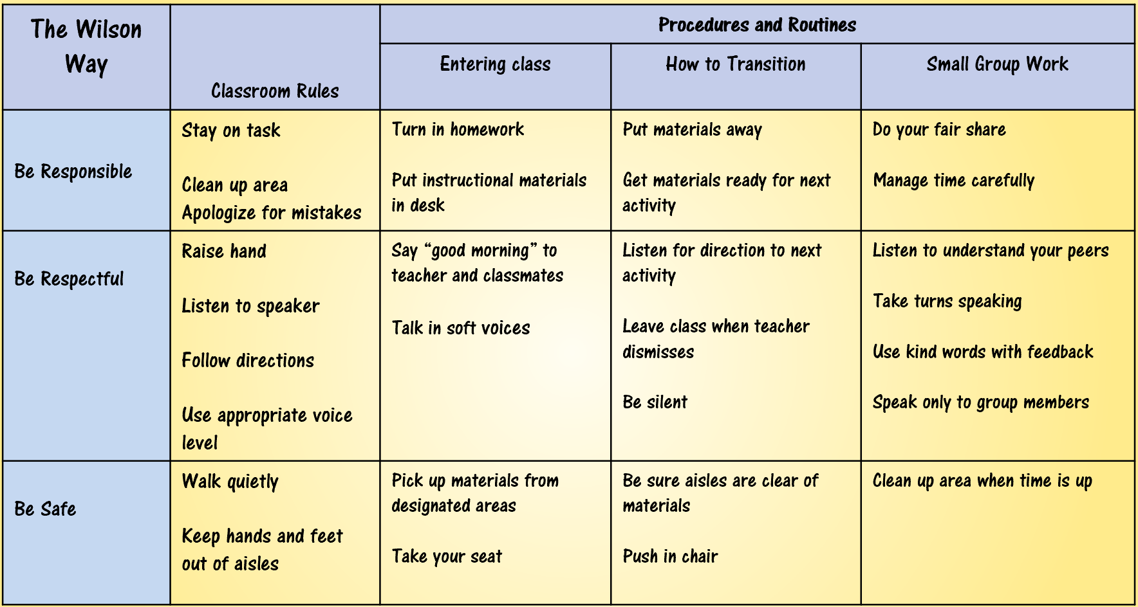
Classroom Procedures & Routines
School-wide Expectations
Social Skills
Classroom Rules

Slide 9


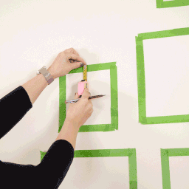
“Obtain student commitment.”
#1: Framing
Create a context of why you are doing what you are doing.
PURPOSE give student a premise of the activity
OUTCOME what will it look like when finished
AGREEMENT what is important to know
LIFE SKILLS what skills will be addressed

Slide 10
Morrison’s R.U.L.E.S. | Transition (Start/End/Break) | Direct Instruction | Group Work | Individual Work | Middle Room | Room Culture
Respect Willingness to show honor and appreciation and to refrain from violating something | *enter classroom quietly and begin WOW *Wait to pack up until given permission | *Give your full attention to the presenter or activity *Follow directions | *Be kind and courteous to all group members *Stay on task *Complete all work on time | *Use time wisely by quietly staying on task’ *Complete assignment | *Only use computers with permission *Follow the Technology agreement | +Use appropriate language and tone of voice when speaking to teacher and classmates
Unwavering Integrity A steadfast adherence to a strict moral ethical code: Honest | *Use your points or pass to leave the classroom | *Give your full attention to the presenter/activity *Follow directions | *Divide work evenly to group *Create original work and use citations | *Create original work and cite sources when needed | *Follow the Technology Agreement *Create original work use citations | *Honor teacher’s personal space: desk, filing cabinet and cupboard
Leadership The ability to guide, direct or influence people | *Enter classroom only when teacher is present *Be ready with material for day | *Listen attentively *Positively contribute for discussion | *Help your group stay focused *Help manage the group’s tasks *Openly communicate | *Use time wisely *Quietly stay on-task *Encourage others to stay focused and on-task | *Notify a teacher if there is a problem | *Be responsible for your work *Track your progress and achievements
Effort Earnest activity intended to accomplish something | *Be in your seat ready to work when the bell rings *Read daily agenda | *Stay on task by: -Following along when reading -Take notes | *Complete all assigned tasks and do your best work *Stay on task | *Complete all assigned tasks and do your best work *Stay on task | *Work diligently and quietly. *Complete all tasks *Do your best work | **Write all homework and test dates in Binder Reminder, daily
Social Responsibility The principle that one should contribute to the welfare of society | *Enter / exit through outside classroom door *Be understanding towards people of different cultures, races, religions and abilities | *Listen attentively *Raise your hand to contribute | *Be understanding of differences *Use an “inside voice” when talking with group *Stay in seat | *Use time wisely *Quietly stay on task *Use time effectively if you finish early | *Use time wisely *Quietly stay on task *Respectfully follow the requests of all teachers | *Use and return classroom supplies *Be understanding towards people of different cultures, races, religions and abilities
“Establish predictable patterns and routines”
Promote operation of classroom”
“Outline the steps for completing specific activities”
“Adopt the three to five positive school-wide expectations as classroom expectations”

Slide 11
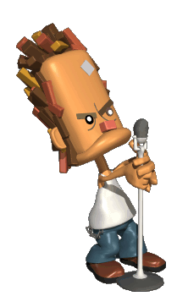
#2: Doing it Together
“Involve students in defining classroom routines.”
“Should be observable, measurable, positively stated, understandable, and always applicable”.
Guidelines: | This means: | Example: | Non-example:
Observable | I can see it | Raise hand and wait to be called on | Be your best
Measurable | I can count it | Bring materials | Be ready to learn
Positively Stated | I tell students what TO do | Hands and feet to self | No fighting
Understandable | The vocabulary is appropriate for age/grade level | Hands and feet to self | Maintain personal space
Always Applicable | I am able to consistently enforce | Stay in assigned area | Remain seated until given permission to leave

Slide 12
Positively
Stated
Observable
Measurable
Applicable

Slide 13
CLASSROOM ROUTINES | SW Social and Academic Expectations
 | Commitment | Honor | Self-Direction
AGENDA/ TO-DO/ TODAY’S WORK ROUTINE
ENTERING THE CLASSROOM
TURNING IN ASSIGNMENTS
ASSIGNMENT TRACKING
Notes:
Center on Adolescent Research in Schools
Agenda/ To- Do/ Today’s Work Routine
The Agenda routine is a teacher routine that informs students what will occur during the class and reduces student confusion (―What page are we supposed to be on?‖). Teach students that the Agenda (or To Do list or Today‘s Work list) will be posted in the same place each day and will list important information such as assignments, page numbers, and homework. Limit the Agenda to no more than 4 or 5 items so work appears manageable. No one likes long To Do lists! The Agenda routine can also help the teacher to stay on track and complete lesson objectives or collect progress monitoring data (e.g., student behavior points). It may be motivating to students to write the Agenda on the board for you or to check off each item on the Agenda as it is completed.
Entering the Classroom
Valuable instructional time can be lost due to inefficient transition to the classroom. Instead of having to repeat directions as students are entering the class or for latecomers, establish a routine for what students should do when they enter the classroom. Steps could include how to knock at the door, where to find lesson materials, where to sit, and when to begin working. A sample routine in a high school classroom may be:
Knock Appropriately- Quietly knock on the door no more than three times.
Enter Quietly- Voices and bodies are quiet when entering class.
Go to Your Assigned Seat- Walk to your seat and sit down quietly.
Begin Work- Focus on the day’s lesson or assignment. Ask for help if necessary by raising your hand.
Turning In Assignments
Teach students how and where to turn in their assignments. The routine could look like:
Be sure your name is on your assignment.
Place assignment in designated location.
Return to your seat.
Assignment Tracking
Learning to get in the habit of managing assignments is an important skill for students. Consider establishing a routine at a consistent point in your lesson for students to take out their planners and record homework or upcoming tests. See the Student Planner/Missing Assignment Tracking Intervention for sample tracking forms and procedures to help students complete the work necessary for their grade.

Slide 14
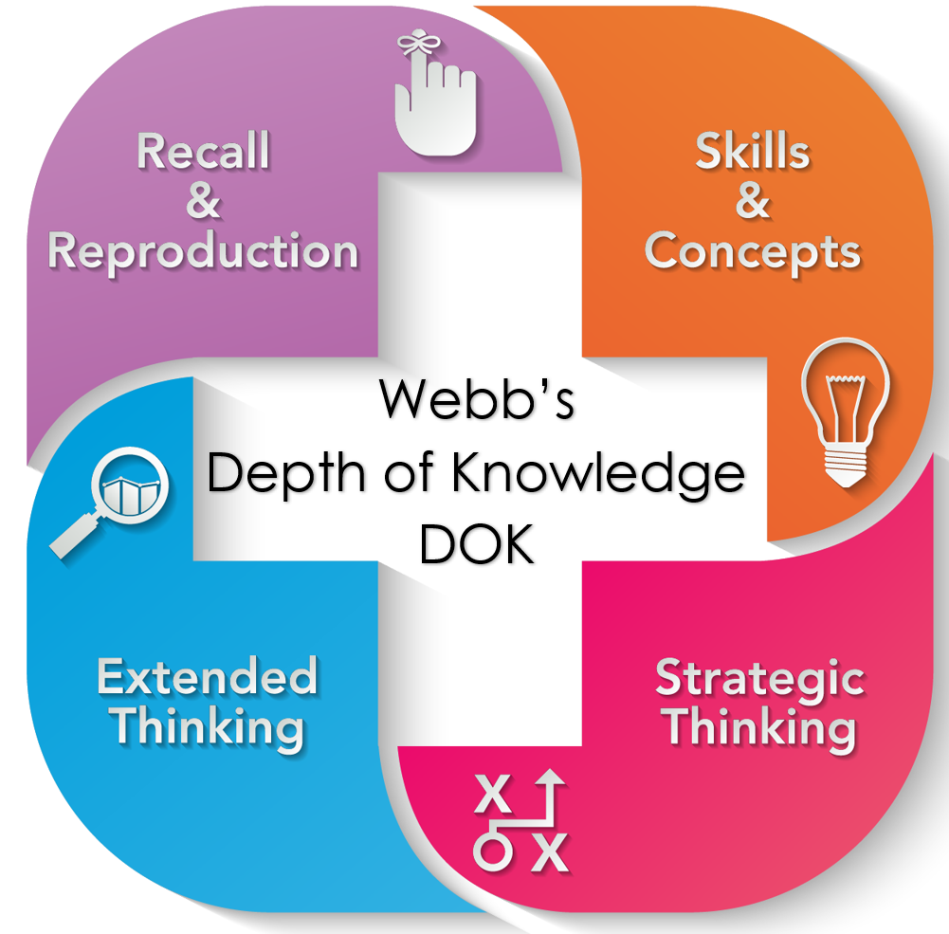
#3: Apply
“Teach routines and procedures directly.”
“Teach using examples and non-examples and with opportunities to practice and receive feedback.”
Explicitly teach & provide opportunity to build fluency and generalize through WEBBS Depths of KNOWLEDGE (DOK)
If a child doesn’t know how to read, we teach.
If a child doesn’t know how to swim, we teach.
If a child doesn’t know how to multiply, we teach.
If a child doesn’t know how to drive, we teach.
If a child doesn’t know how to behave, we… teach? …punish?
-Tom Herner, 1998

Slide 15

#4: Acknowledging Appropriate Behaviors
ACKNOWLEDGEMENT
Verbal statement naming the behavior explicitly and
includes a statement that shows approval:
*INDIVIDUAL or GROUP
*TIMELY
*MEANINGFUL and SINCERE *5 to 1 RATIO
“Recognize students when they successfully follow classroom routines and procedures..”
“Teach expectations using examples and non-examples and with opportunities to practice and receive feedback.”
“Whatever you feed,
will grow.”
~Bishop TD Jakes

Slide 16
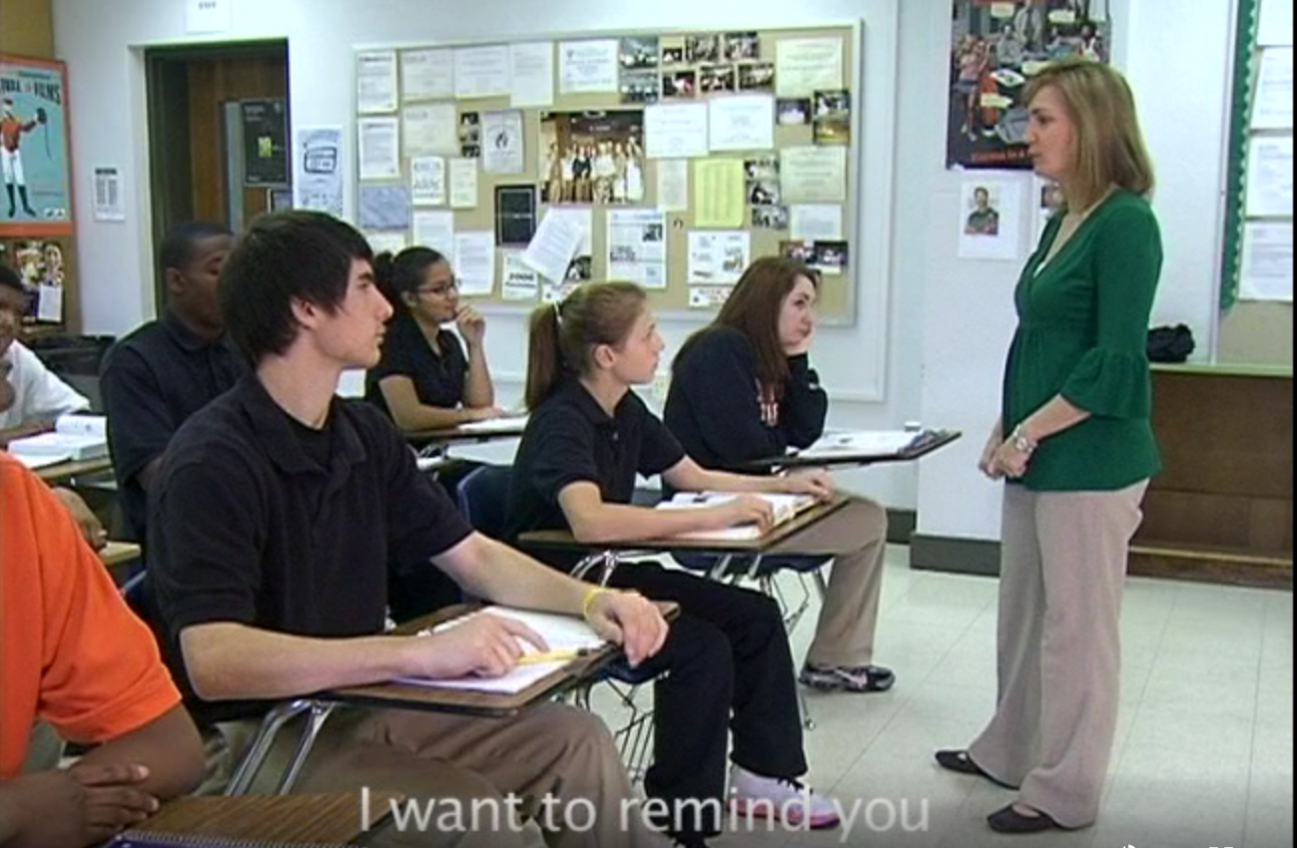
#5: Prompting & Precorrections
““Promote the operations of the classroom.”
Preventative
Understandable
Observable
Specific & Explicit
Self Delivered

Slide 17
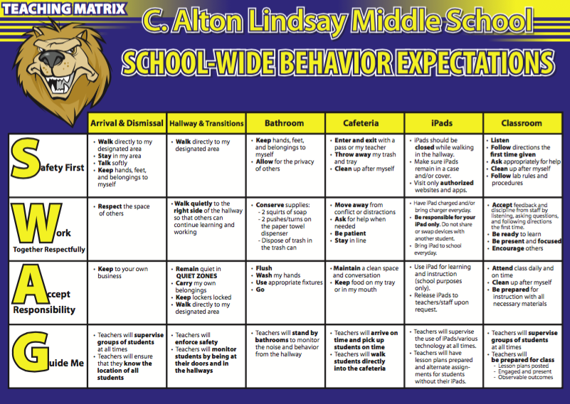
#6: Responding to Challenges
“Create routines and procedures for the most problematic areas or times.”
C. Alton Lindsay Middle School PBIS Team, C. Alton Lindsay Middle School Hampton City Schools, VA
Notes:
What are the challenges/problems? What do you want kids doing instead?
Always asking this question and always reviewing to make sure it reflects your school’s unique challenges
NOTICE: Guide Me – expectations explicitly apply to staff
This school got in front of a new division-wide initiative for students having IPADs
Data
How are we being responsive to our current reality (e.g., outcome data, new initiatives- social emotional skills,bully prevention, technology usage, etc.)?
Do we need to add to our matrix? ACTION ITEM
Practices
Does our school-wide teaching matrix reflect the positive opposites of problem behaviors showing up in our data?
Are the behaviors observable, measurable, positively stated, understandable, and always applicable?
Do we need to rephrase our matrix? ACTION ITEM
Systems
How will we engage staff, families, students with teaching matrix to solicit feedback to inform or to review revisions?
Do we need a plan to involve stakeholders with our matrix? ACTION ITEM

Slide 18
Continuum of Strategies to Respond to Inappropriate Behavior
Highly effective teachers have a toolkit of respectful strategies that diminish the frequency, intensity, and/or duration of inappropriate behaviors.
Empower students and teach resiliency skills
Replace learned responses with appropriate behavior
Helps students regulate their emotions
“Create routines and procedures for the most problematic areas or times.”
Use the
POWER of the Classroom Matrix
Notes:
The rationale for using a continuum of responses are that we need to have a tool kit to diminish the frequency, intensity, and duration of inappropriate behavior. There is also no single strategy that works for all students all the time. We must also start to think about function of the behavior as we use strategies with individual or groups of students.

Slide 19

Planned Ignoring
Physical Proximity
Signal/ Non-Verbal Cue
Direct Eye Contact
Praise Appropriate
Behavior in Others
Redirect
ERROR CORRECTION Use brief, contingent, and specific error corrections
Calm Consistent Brief Immediate Respectful Specific
Prompt Redirect Re-teach Provide choice Conference with the student
Re-teach
Praise Approximations
Specific
Error Correction
Provide Choice
Restorative Conferencing
Notes:
This graphic lays out the continuum starting with less intensive strategies moving toward more intensive. Many teachers naturally use things like planned ignoring or physical proximity to stop a behavior. And sometimes we need to be more specific with error correction, choice, or a conference with a student. Let’s walk through each of them.

Slide 20
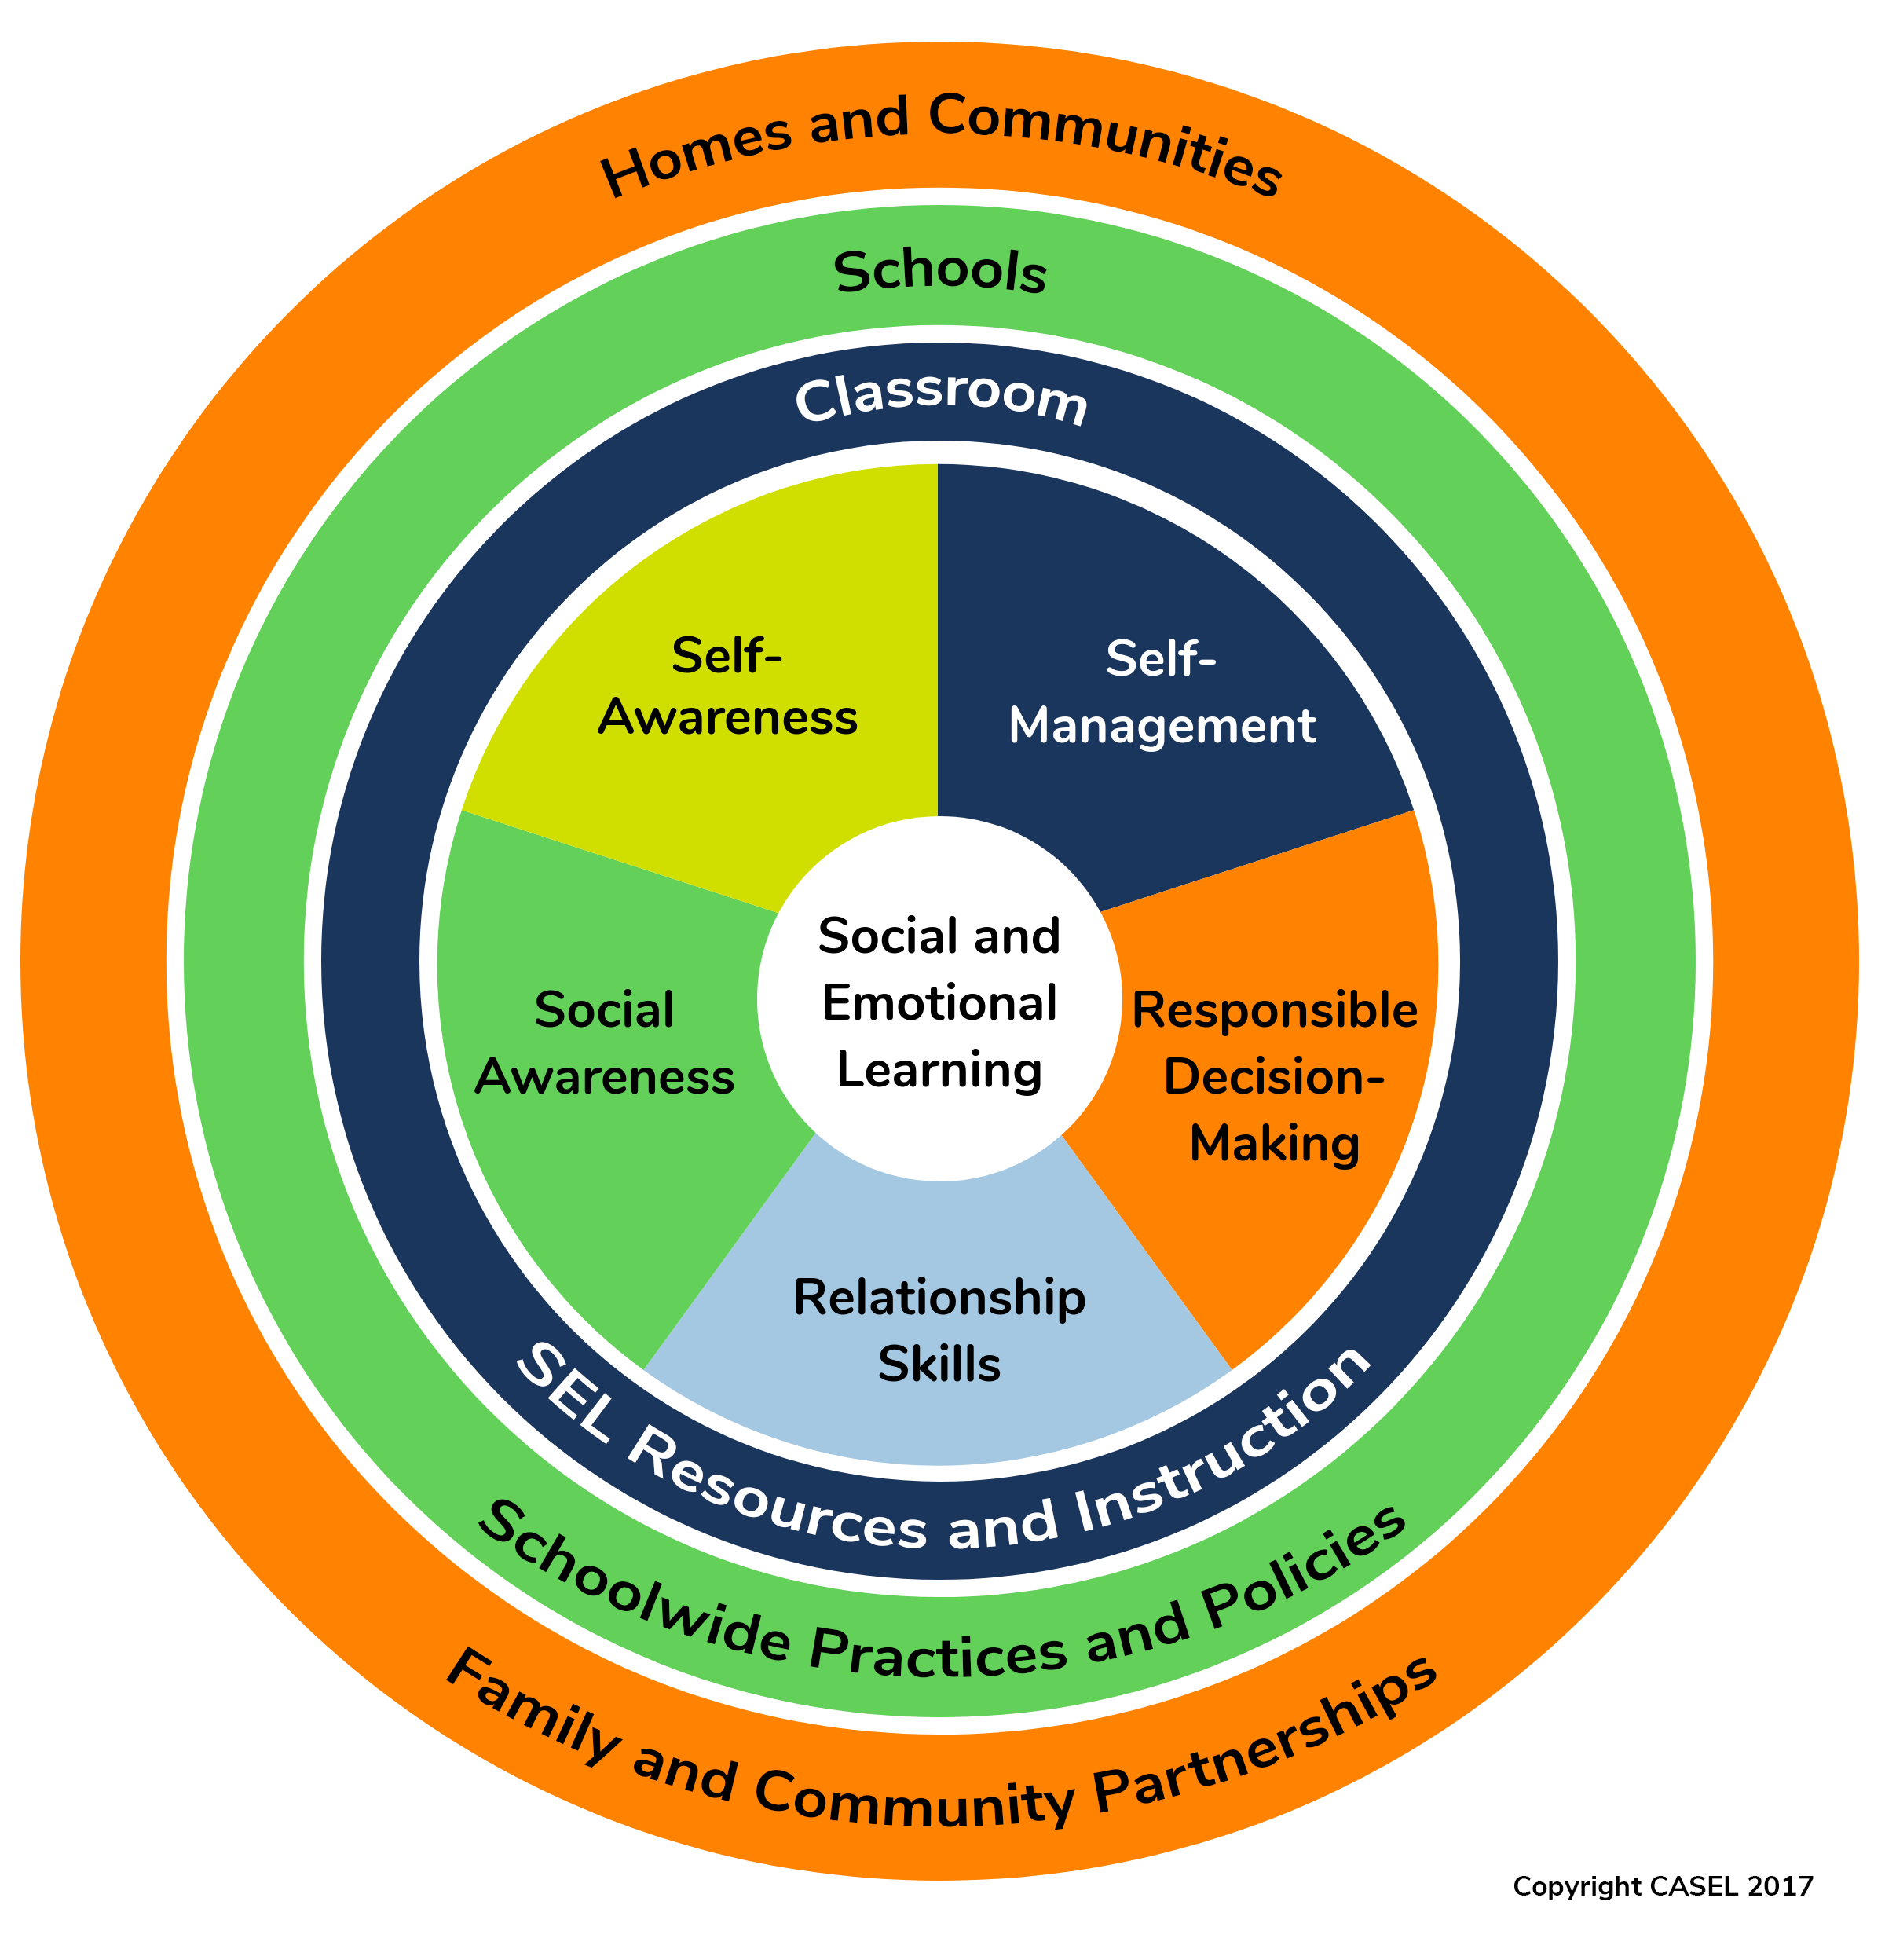
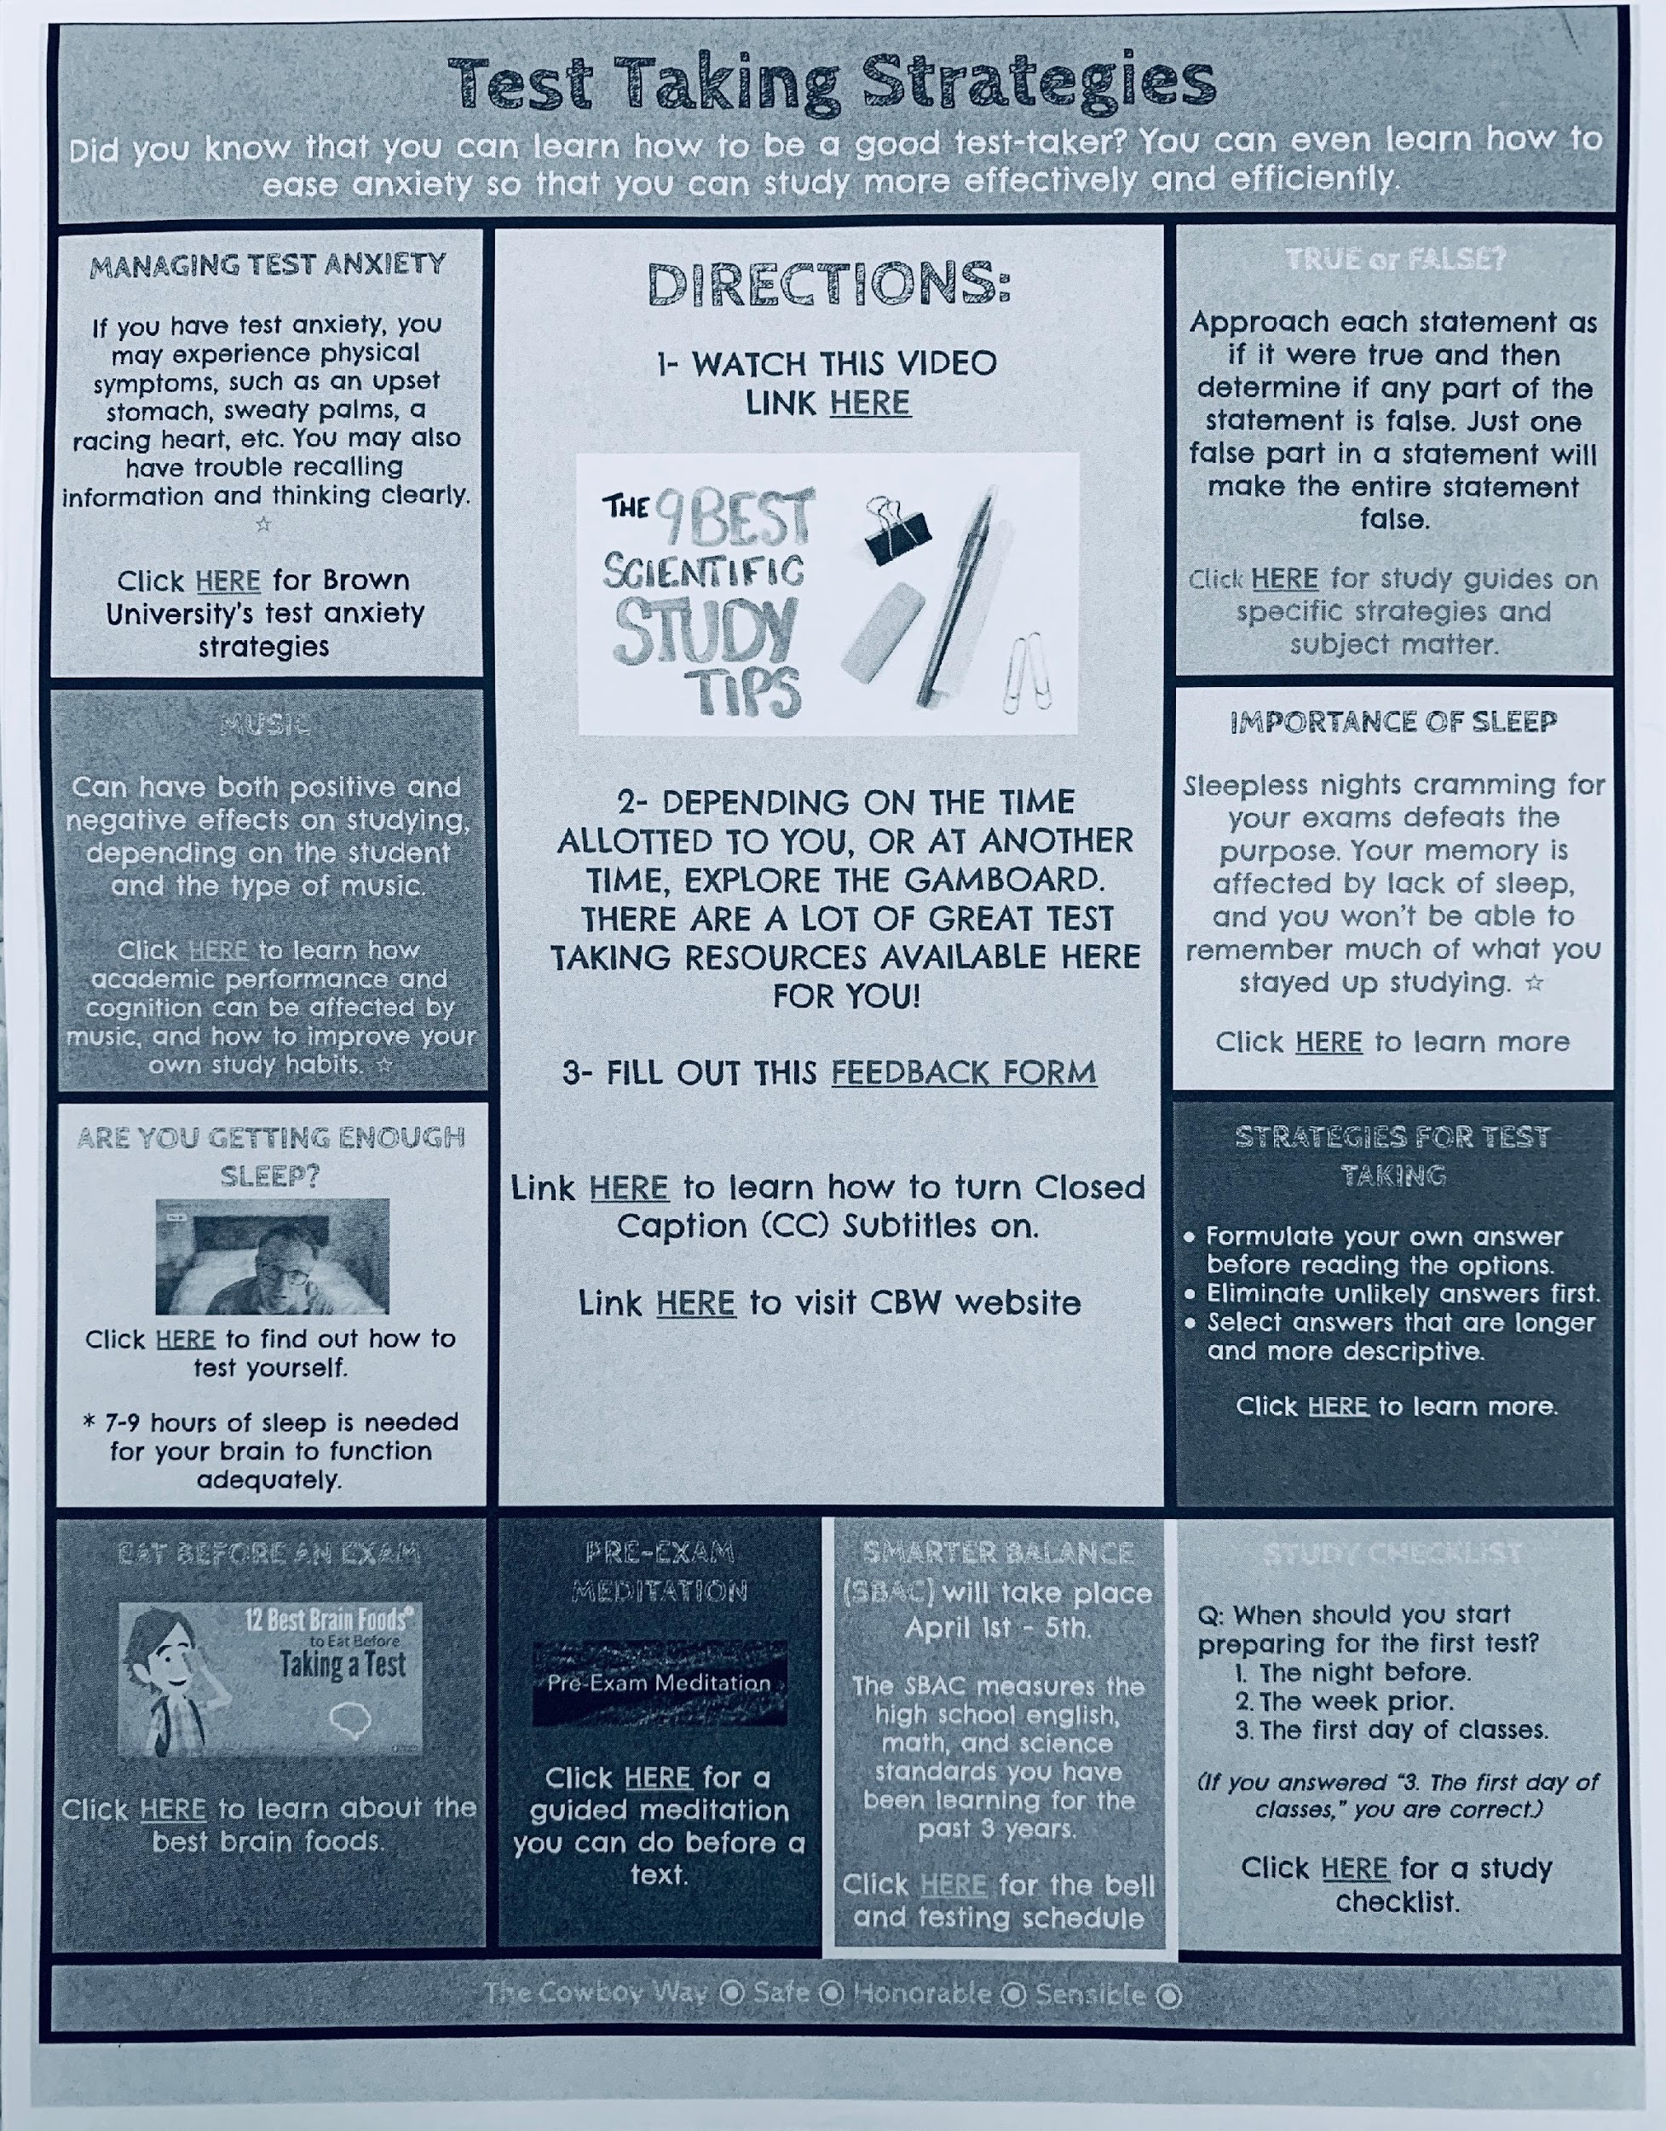
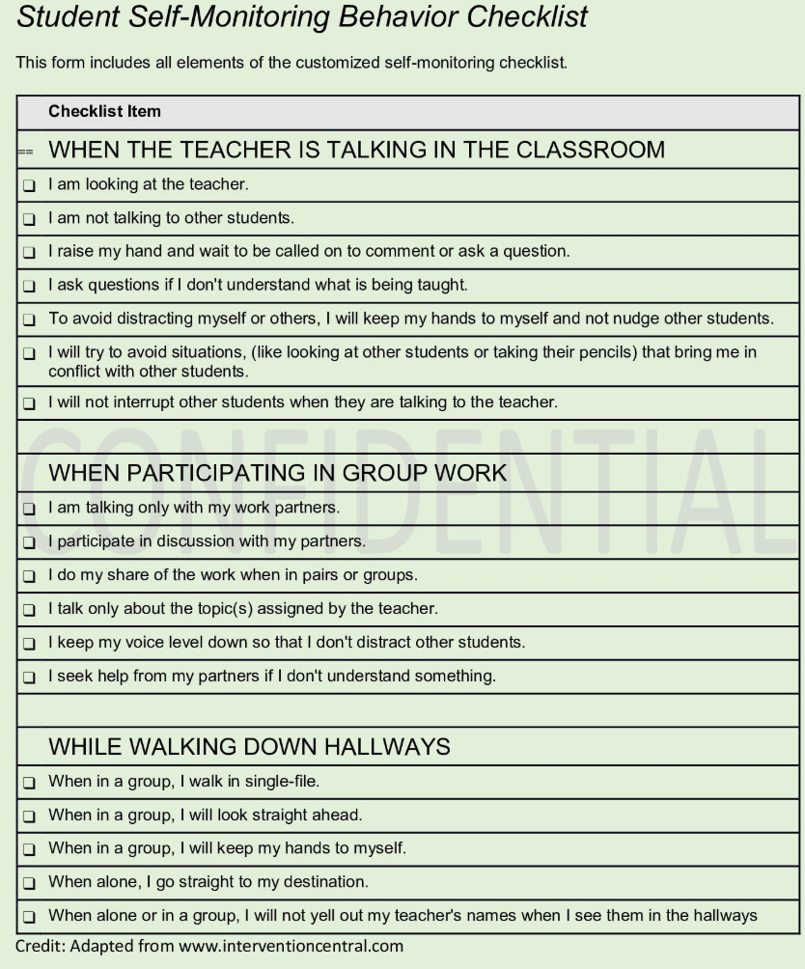

“Promote self-managed or student-guided schedules and routines.”
STEP 7: Self-Monitor
Self-Management and self-evaluation allowing initiation to be prompted by normal events rather than relying on teacher prompts.
Salinas
High School

Slide 21
STEP 8: Alignment
Use your matrix as a tool for alignment
Consolidate language into one document (framework)
Crosswalk initiatives and map expectations

Slide 22

ALL STUDENTS – ALL NEEDS
Meet needs of the whole child:
Behavior
Social Emotional
Academics
Mental Wellness
Additional Lenses:
Trauma informed
Culturally responsive
Equitable practices
MTSS, YMHFA, Restorative Practices, Trauma Informed

Slide 23
Emotion and Intellect Intertwined
Academic Content
Academic Standards
Graduation Requirements Social/Emotional
Social Emotional Skills
Academic
Enablers
Organizational Skills
-Study Skills
-Group Process
-Time Management
Communication Skills
Healthy Relationships
Managing Stress
What are the skills required to succeed in college, career, and life?
And…if we ask employers
“What are the skills you are looking for in a potential employee?”

Slide 24
Specific Behaviors + Pro-Social Skills
Specific Behaviors | Pro-Social Skills
Pick up after yourself | Respect the environment; recycle Pick up trash even if it isn’t yours
Walk without electronics | Be available to hear/listen; drivers need it to be safe
Respect and support your peers | Choose kindness over being right Encourage others; tell peer they did a good job Help others in need (academic support, emotional support..)

Slide 25
The Wilson Way | Classroom Rules | Classroom (Attention Signal: Hand raised)
 |  | When you feel upset … | Entering class | How to Transition/ | Small Group Work
Be Responsible | Stay on task Clean up area Apologize for mistakes | Recognize what you’re feeling “I feel…” Stop and take a few deep breaths | Turn in homework Put instructional materials in desk | Put materials away Get materials ready for next activity | Do your fair share Manage time carefully
Be Respectful | Raise hand Listen to speaker Follow directions Use appropriate voice level | Ask for a break if you need a moment Express your feelings appropriately | Say “good morning” to teacher and classmates Talk in soft voices | Listen for direction to next activity Leave class when teacher dismisses Be silent | Listen to understand your peers Take turns speaking Use kind words with feedback Speak only to group members
Be Safe | Walk quietly Keep hands and feet out of aisles | Talk to someone if you need help or if it makes you feel better 800-suicide | Pick up materials from designated areas Take your seat | Be sure aisles are clear of materials Push in chair | Clean up area when time is up
Social Emotional /
Mental Wellness

Slide 26
College and Career Ready
Engagement Actively participate Arrive and leave prepared Be an active listener Be on time Be ready to learn Complete homework Follow adult directions Listen attentively Maintain focus on the lesson Participate positively Stay on task | Critical Thinking Complete assignments Create authentic work Practice academic honesty Find resources to help you pass every class Give and receive feedback respectfully Know the resources available Produce quality work Think critically, creatively and collaboratively to overcome challenges Use research materials to improve our learning
Mindset Accept responsibility for your actions Ask for help appropriately Push yourself to achieve your best Attend school activities and events Be a good citizen Challenge yourself to do your best Foster school spirit | Learning Process Check grades weekly Check your assignment notebook to make sure you have your materials to do your homework Cooperate with others Develop good study habits Follow guidelines in student planner

Slide 27
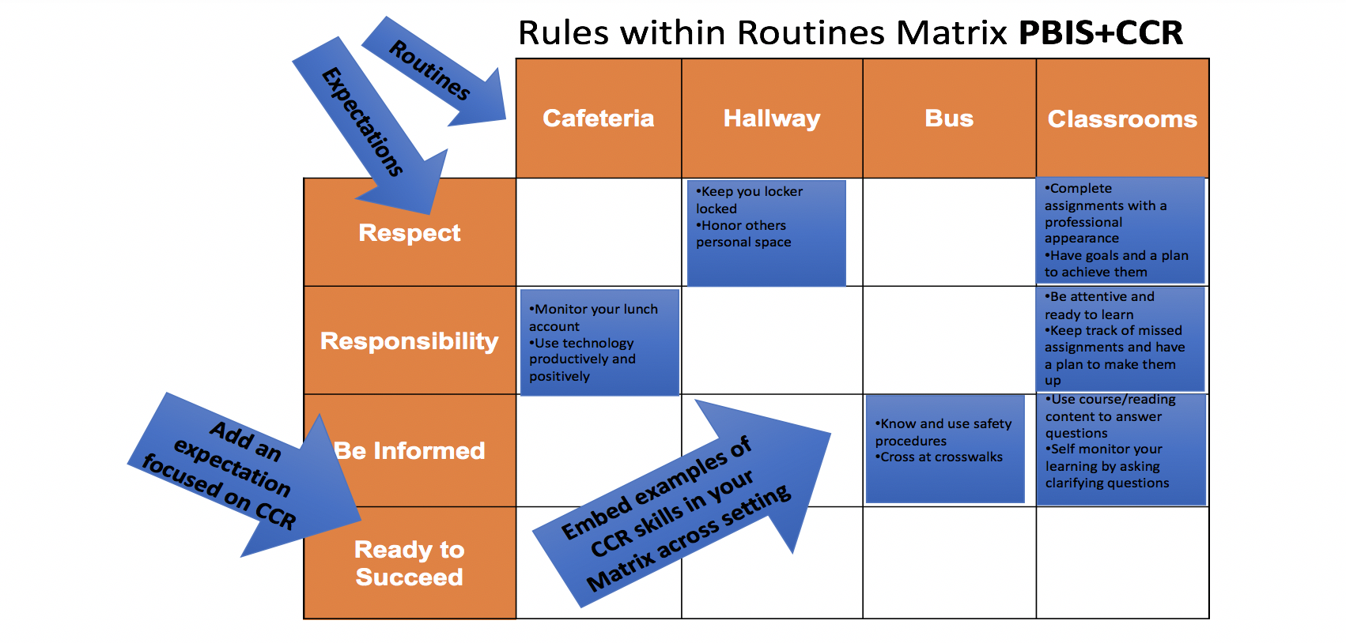
College and Career Readiness

Slide 28
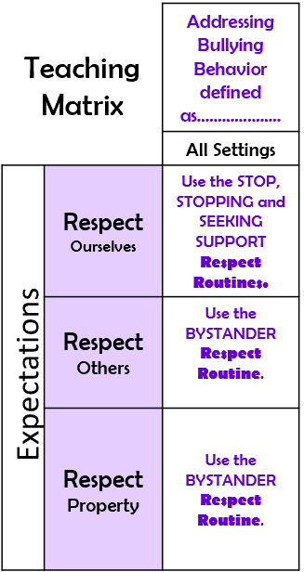

Bully Prevention

Slide 29
Teaching Matrix |  | SETTING
 |  | All Settings | Hallways | Bruin Block | Cafeteria | Library/ Computer Lab | Assembly | Bus
 | Respect Ourselves | Be on task. Give your best effort. Be prepared. | Walk. | Have a plan. Make appointment w/teacher | Select healthy foods. | Study, read, compute. | Sit in one spot. | Watch for your stop.
 | Respect Others | Practice kindness | Use normal voice volume. Walk to right. | Keep music low | Practice good table manners | Low volume. Return books. | Listen/watch. Use appropriate applause. | Use a quiet voice. Stay in your seat.
 | Respect Property | Recycle. Clean up after self. | Pick up litter. Maintain physical space. | Use technology properly. Put litter in garbage can. | Replace trays & utensils. Clean up eating area. | Push in chairs. Treat books carefully. | Pick up trash from bleachers | Wipe your feet.
1. Expectations
BUILD RESPECTFUL ENVIRONMENT
2. NATURAL CONTEXT (Settings/Social Emotional wellness
Expectations
Invite others to join a club you are in.
Invite people
who are alone
to join in your conversation.
Use social
media
for ‘good’
3. Specific Behaviors

Slide 30
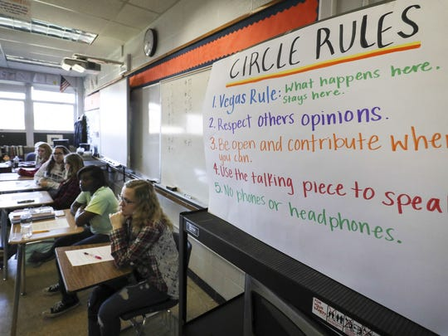
Restorative Practice Routine: Classroom Circles
Integrity
Honor Self & Others
Social Responsibility
PROSOCIAL & ACADEMIC CIRCLES CHECKLIST
1. | Circles are used both in classroom and non-classroom settings
2. | Circles are used for community building / welcoming
3. | Circles are used for restoring or repairing harm.
4. | Restorative circles, or other circles to repair harm, are co-facilitated by the RP Coach or administrator as agreed upon by staff.
5. | Purpose of circle is clearly stated before the circle begins
6. | Circle keeper is identified for each circle event (can be staff or student)
7. | Circle keeper consistently states circle guidelines
8. | Circle keeper initiates dialogue using a talking piece
9. | Circle keeper provides the opportunity for all participants to speak in turn
10. | Circle guidelines have been aligned to SW Expectations
11. | Students have contributed to establishment of circle values

Slide 31
CULTURAL RESPONSIVENESS
 | At SCHOOL it looks like… | At HOME it looks like… | In my NEIGHBORHOOD it looks like…
Be Safe | Keep hands and feet to self Tell an adult if there is a problem Eat your own food | Protect your friends and family Don’t talk back Share your food | Don’t back down Look the other way Don’t stand out
Be Respectful | Treat others how you want to be treated Include others | Do exactly what adults tell you to do Don’t bring shame (Honor your family) | Be nice to friends’ parents Stick up for your friends
Be Responsible | Do my own work Personal best Arrive on time Clean up messes | Help your family out first Meet my siblings at the bus stop on time | Have each other’s backs Own your mistakes

Slide 32

You Hold
the Power of the
Classroom Matrix
Cristy Clouse cristy@pbiscaltac.org
Patti Hershfeldt phershfe@odu.edu
Barbara Kelley barbara@pbiscaltac.org
www.pbiscaltac.org

Slide 33


Slide 34
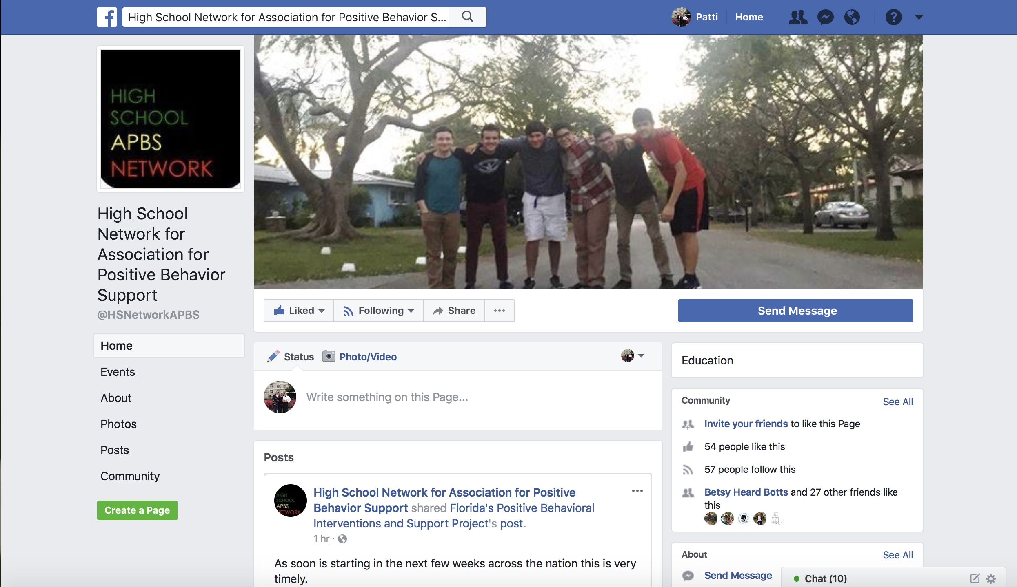
Join us on Facebook https://www.facebook.com/HSNetworkAPBS/

